Slide 1

Land Management Update
Ben Thorne, FWAG SW

Slide 2

Key Action
Somerset partners (FWAG SW, Royal Bath & West, RSPB, SWT, Catchment Sensitive Farming) to pilot an integrated advice and support package to promote natural flood management and land management adaptation throughout the catchment
Funding 2015-2017: £550k from LGF, £573k from Dream Fund, £100k from Princes’ Countryside Fund, £34k from Catchment Partnership Action Fund, £46k from SRA, £68k from EA Environment Programme

Slide 3

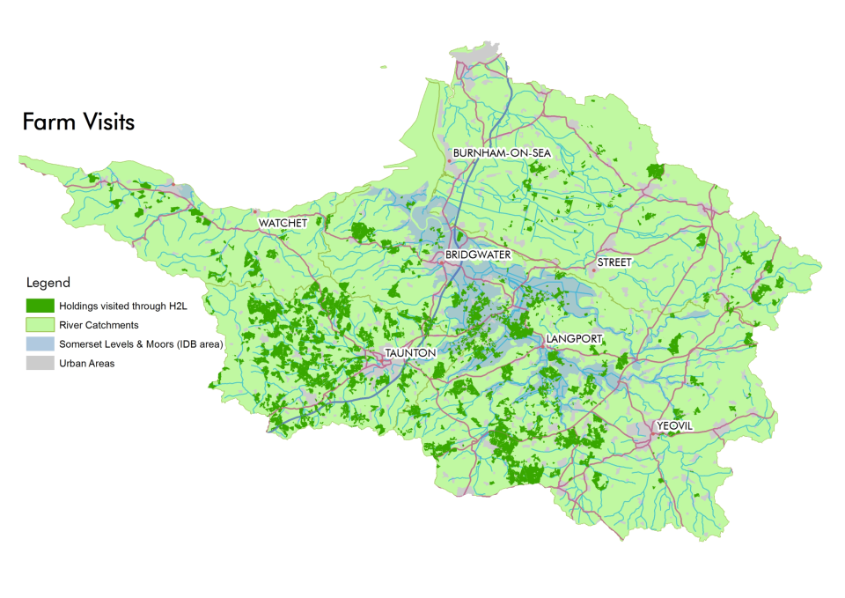

Slide 4
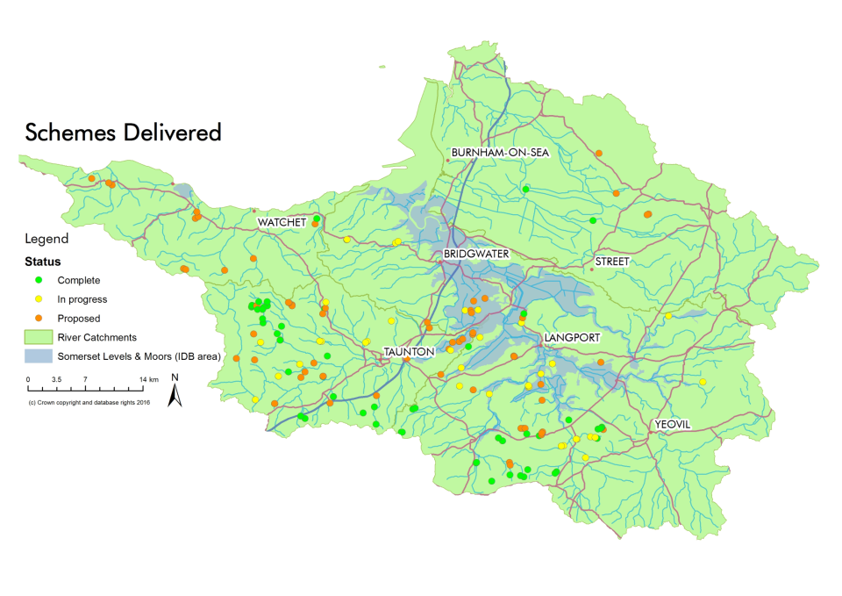


Slide 5
Land Management Schemes | Schemes
 | Proposed/underway | Complete
In-channel (woody dams, gabions, bank stabilisation) | 24 | 25
In-field (filter fences, soxx, coir rolls) | 12 | 12
Water storage (leaky pond, scrapes, floodplain storage, bunds to hold water) | 38 | 15
Strategic planting | 7 | 3
Rainwater Harvesting | 6 | 3
Infrastructure (e.g. cross drains, fencing, yard improvements; Levels: droves, culverts) | 29 | 9
Shared machinery | 3 | 2

Slide 6
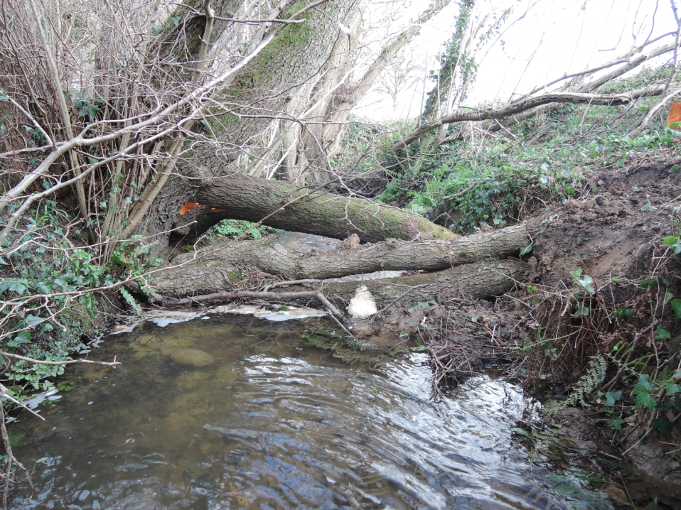
Woody Dams

Slide 7
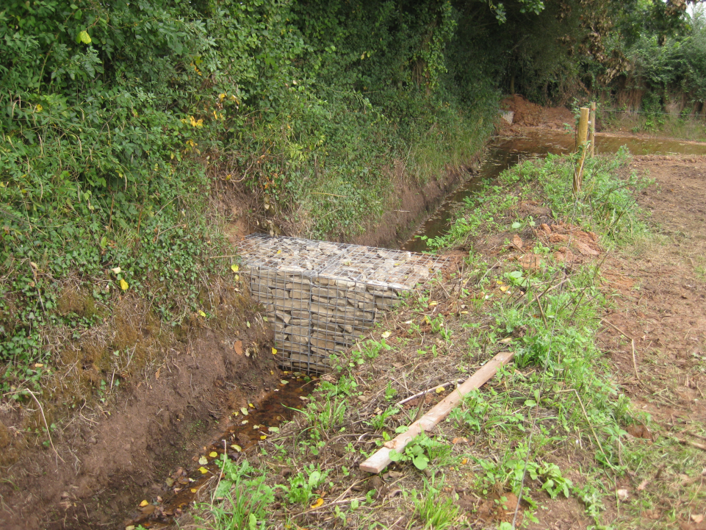
Ditch gabions

Slide 8
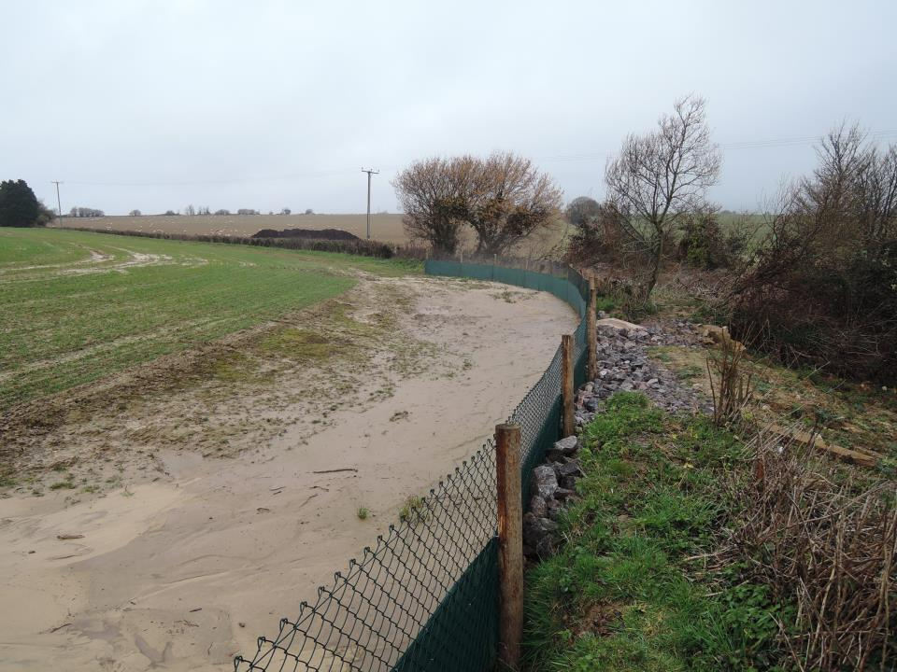

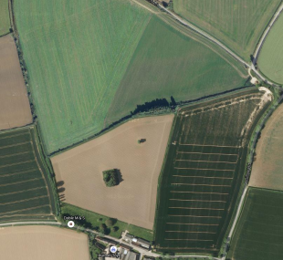
Filter fence

Slide 9
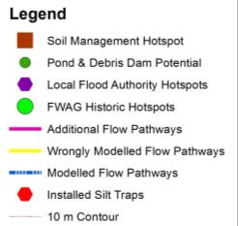
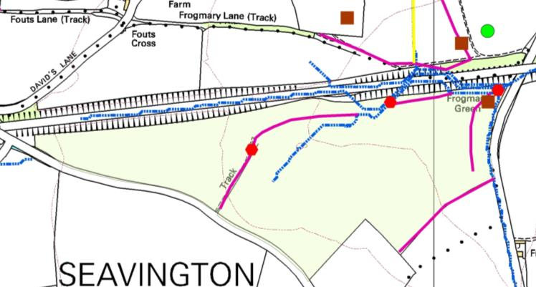
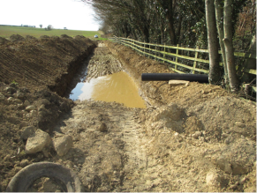
Silt trap

Slide 10
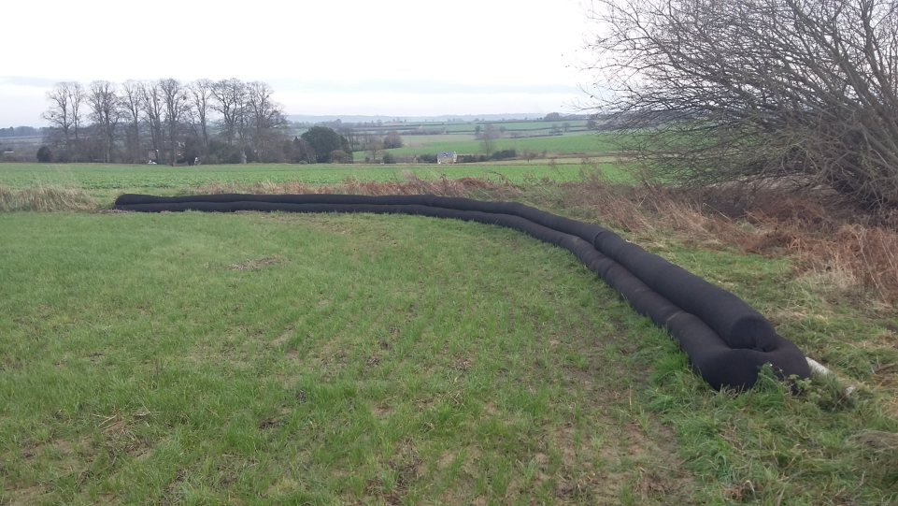
Filter Soxx

Slide 11
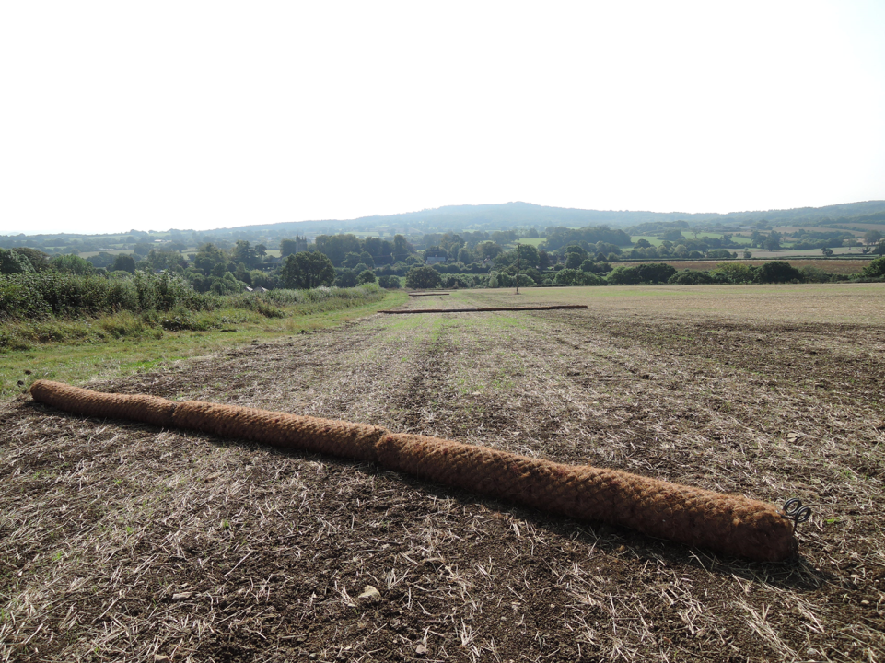
Coir rolls

Slide 12
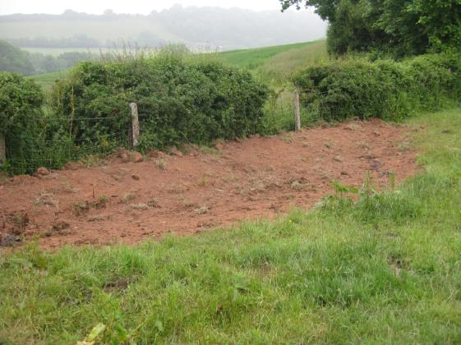
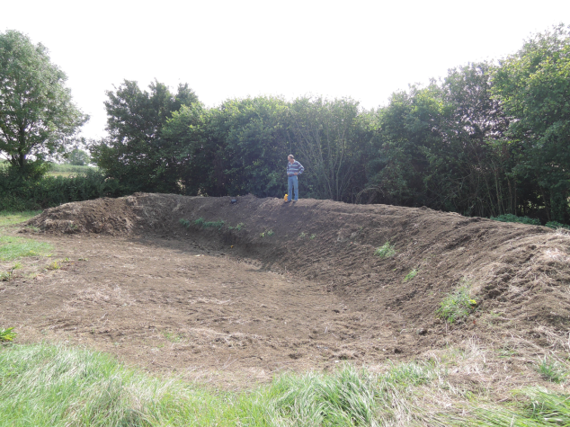
Soil bunds

Slide 13
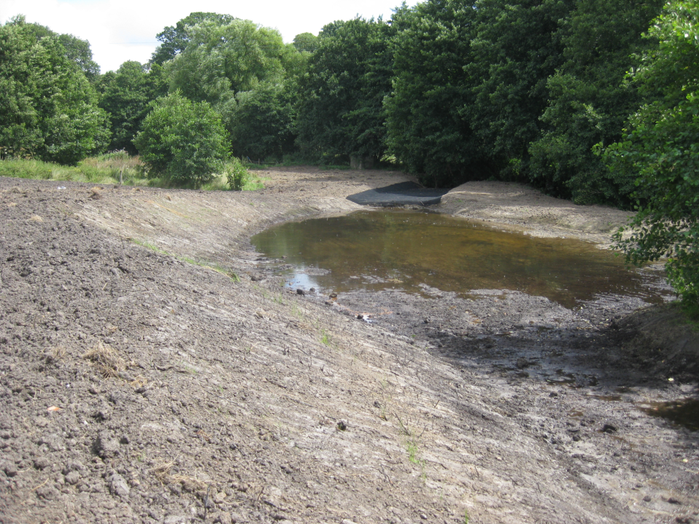
Floodplain scrapes

Slide 14
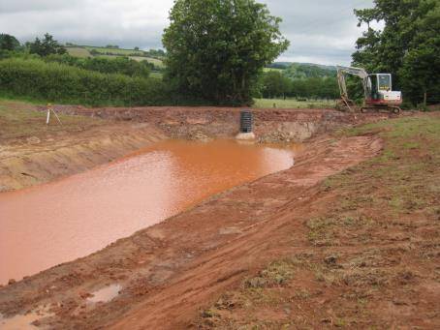
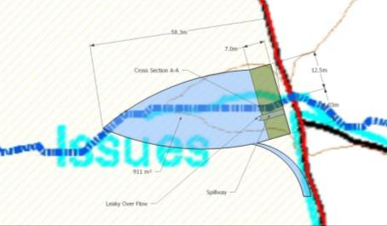
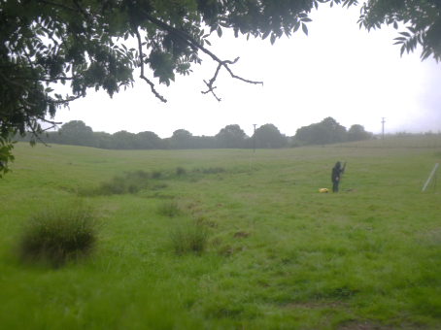
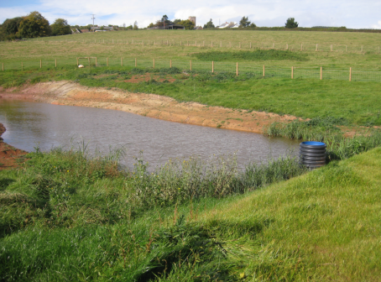
Leaky Pond
During
Before
After

Slide 15
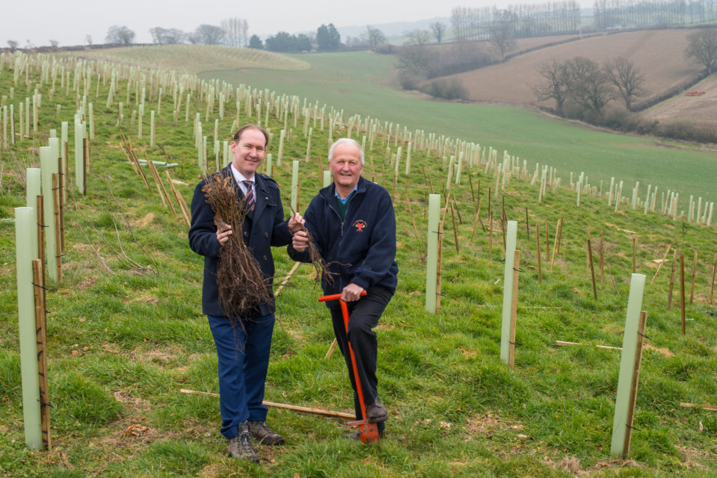
Strategic planting

Slide 16
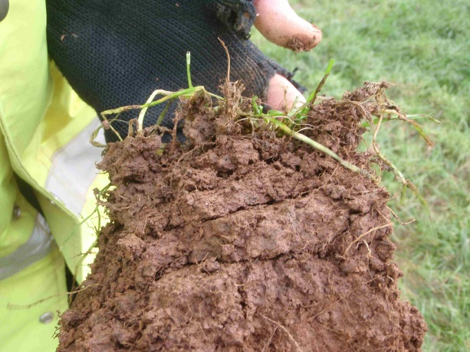
Soil Management

Slide 17
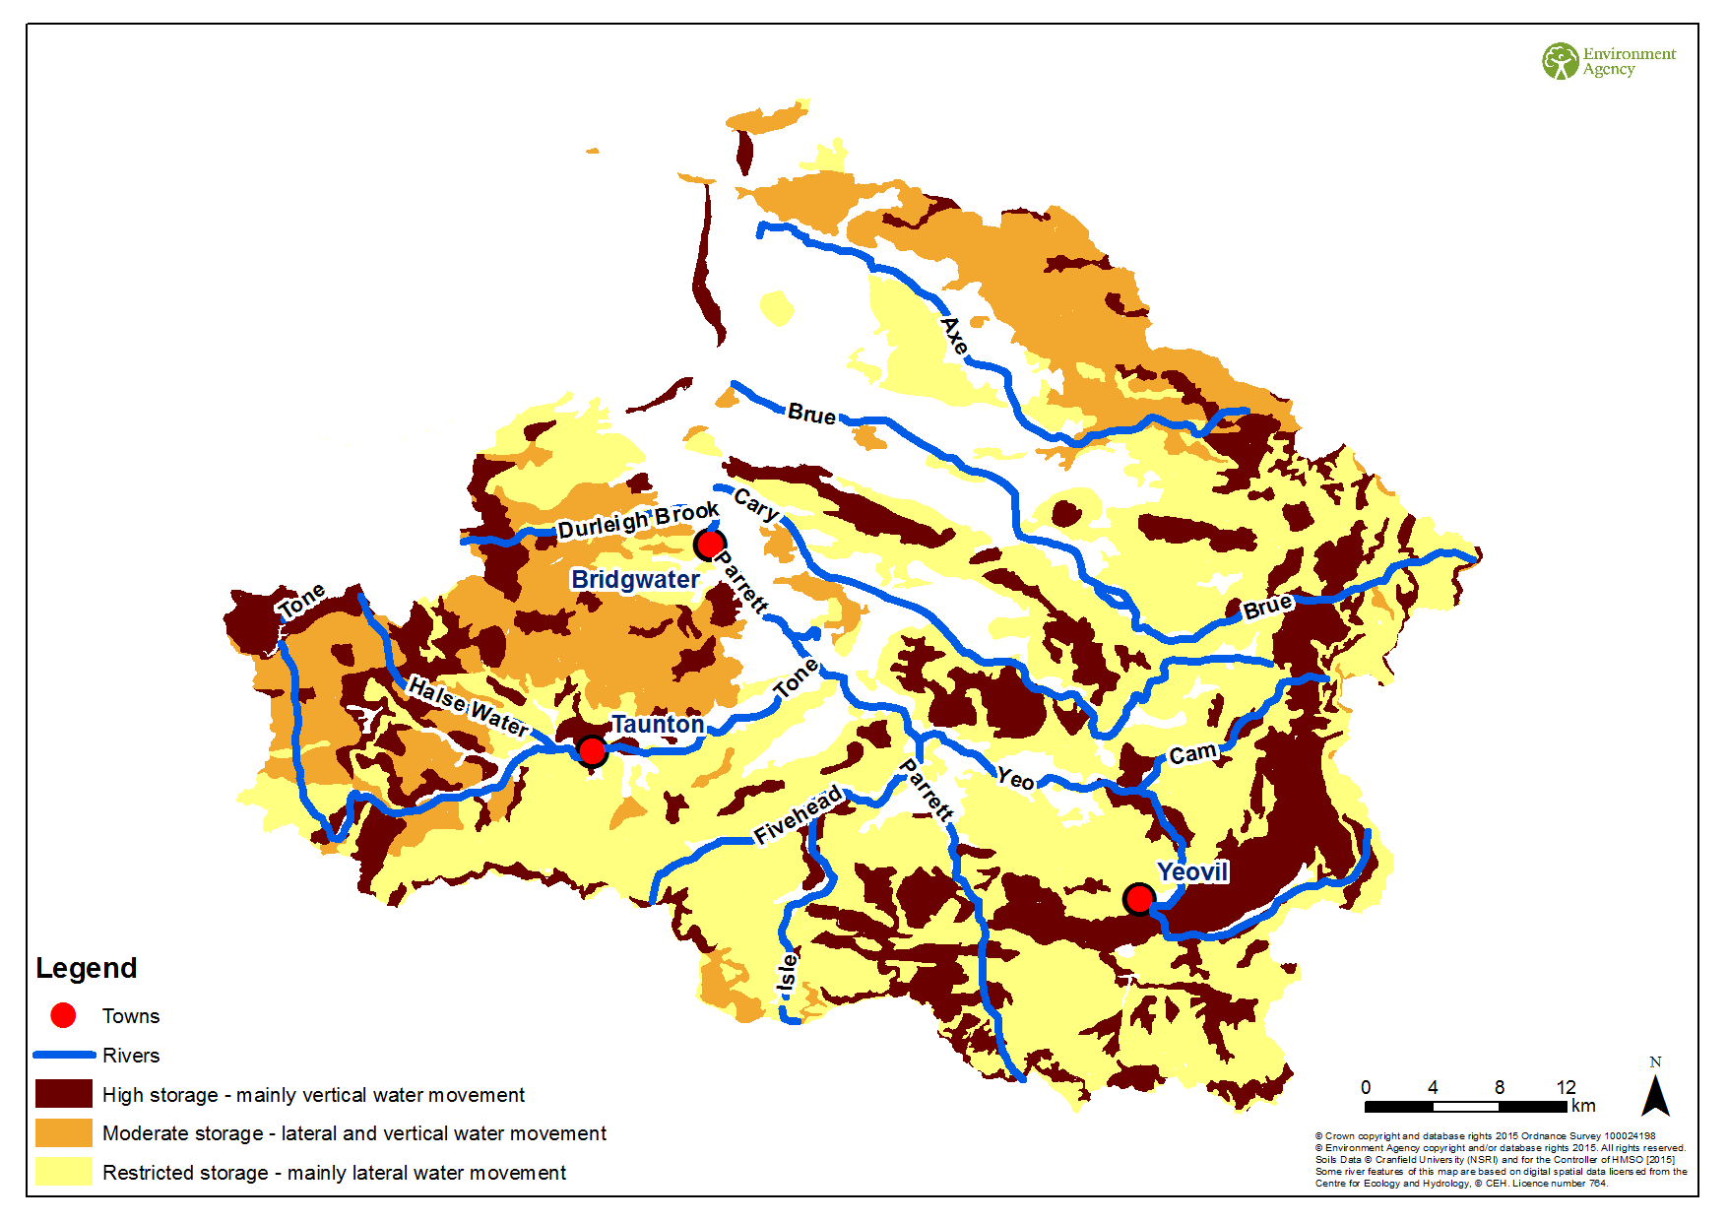
Soil Water Storage

Slide 18
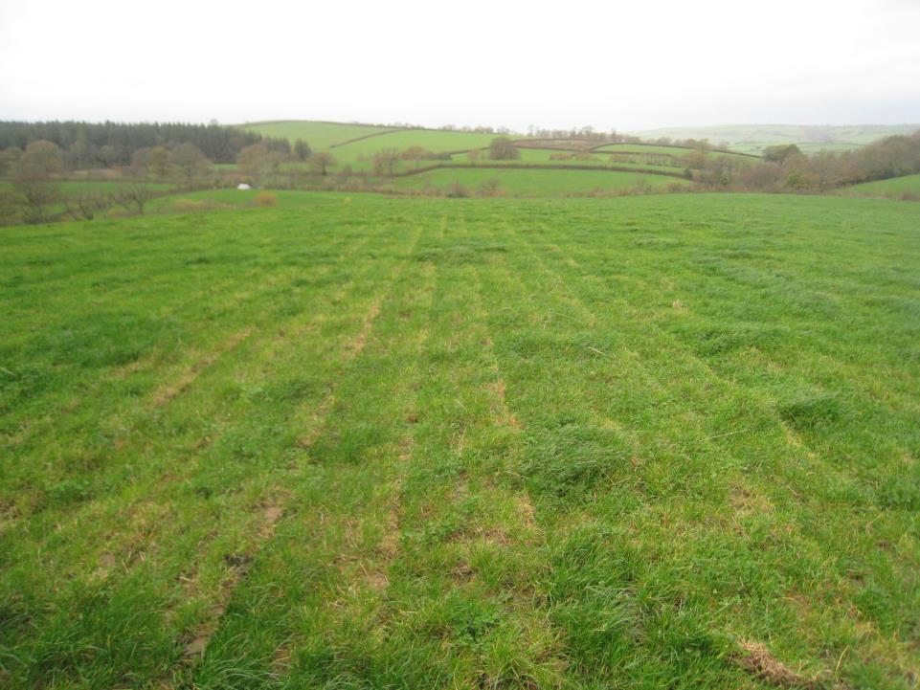
Sub-soiling

Slide 19
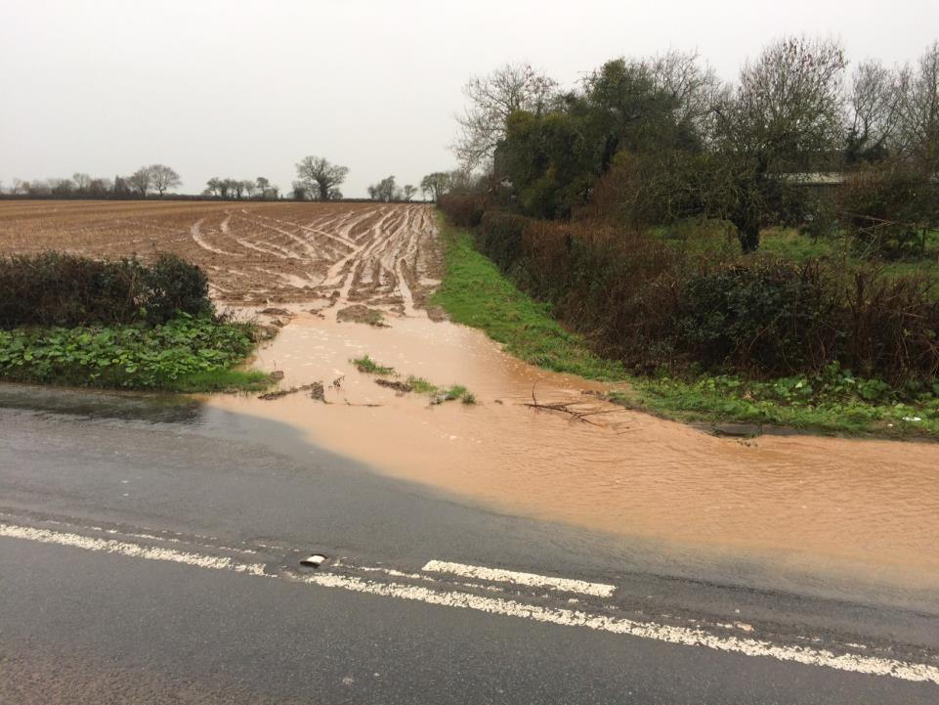
Working with Highways

Slide 20
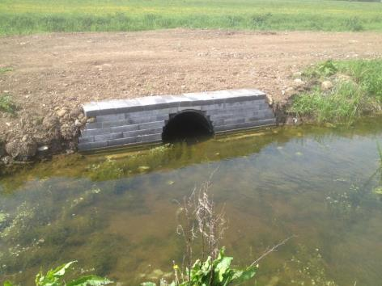
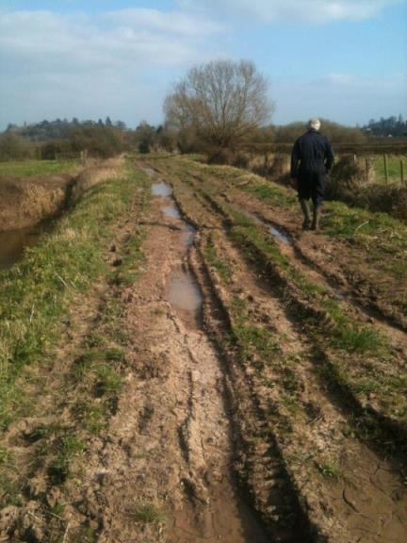
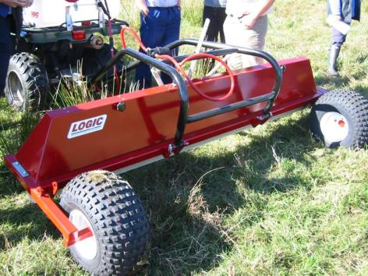
Farm Resilience on the Levels

Slide 21
Land Management Issues
NFM growing public interest
Consents and Permits
Long-term funding
Local vs catchment scale flooding
SRA ‘buy-in’ to catchment flood management

Slide 22
Key Action
Examine innovative mechanisms such as developing a Community Land Management Trust
Funding 2015-2017:£56k from Dream Fund, possible £27k from SRA in 2017

