Slide 1



Bridgwater Tidal Barrier Scheme
Update for Somerset Rivers Authority

Slide 2
Recent Progress
    Consultation on preferred 2 sites
    Chosen 2 preferred gate types / arrangements
    Downstream impacts better understood
    Working with key stakeholder group to consider silt management and navigation
    Achieved support from Parrett IDB – DESIGN FOR FLEXIBILITY

Slide 3
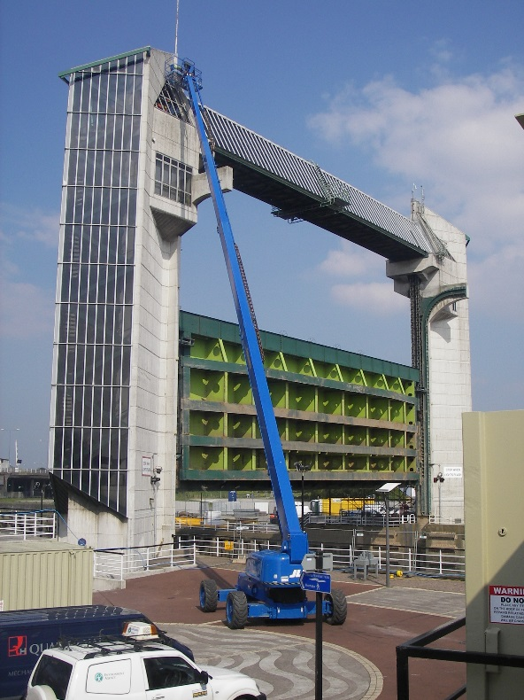
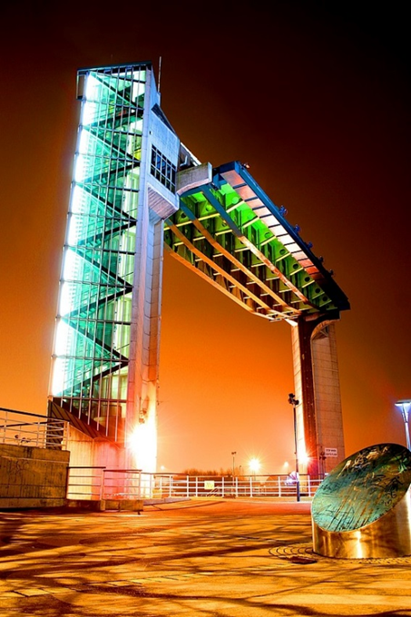
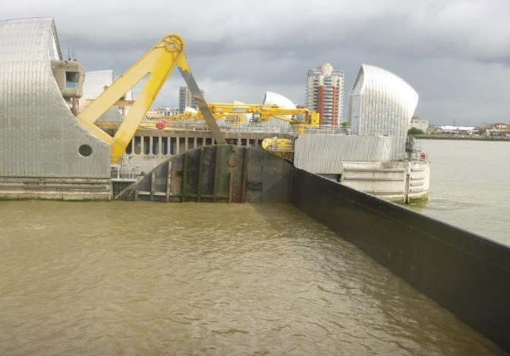
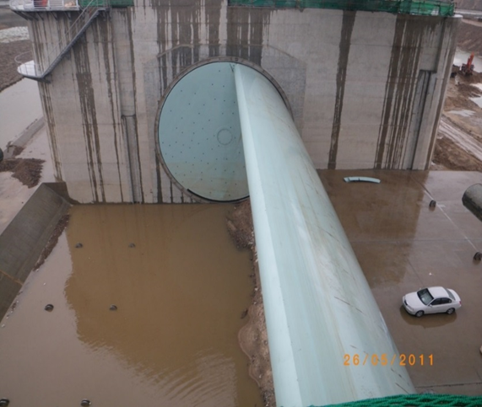
Choice of Potential Type of Barrier
Vertical Lift Gate Rising Sector
Hull Barrier

Slide 4
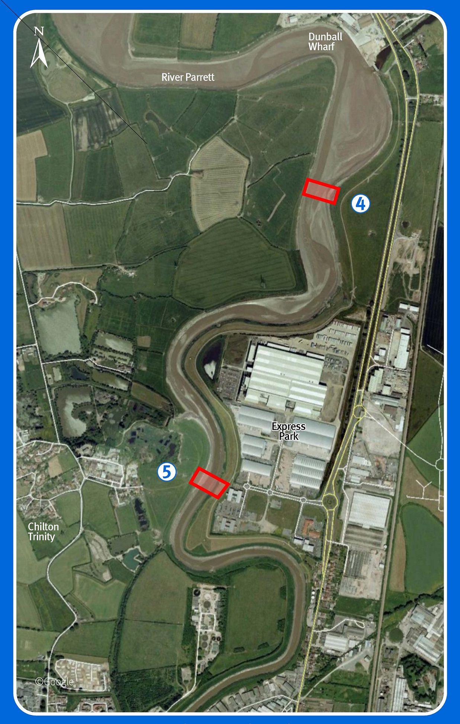
Preferred sites
Site 4
More benefit to growth
Less constraints on building
Risk of siltation at Dunball
Public preference
£65M-£80M
Site 5
More impact on existing buildings/people
Not so helpful in promoting growth
Less fluvial storage
£45M-£60M
Notes:
Least impact on the town and population – downstream sites preferred
Least impact on natural environment – upstream site preferred
Most capacity for fluvial flood storage – downstream site preferred
Least impact on navigation/Dunball Wharf – upstream site preferred
Most help for new development in north Bridgwater – downstream site
Least cost – upstream sites
Best site will be a compromise

Slide 5
Why the cost increase?
Preferred sites farther downstream than before – bigger structures
Works to downstream banks likely to go as far as Combwich
Upward pressure on construction prices (eg steel)
Includes land acquisition and legal processes
Allowed greater contingency for unknowns

Slide 6
What does this mean for funding?
    More FDGiA available if contributions rise too
    SDC confident of increasing contributions from CIL
Likely targets for extra contributions
LEP Growth Deal
Puriton Enterprise Zone (benefits from protected transport links)
Business Rate Retention (may be focussed on individual businesses)
Notes:
SDC £6M-£7M already committed from ongoing development
CH2M Hill will support SDC in working through the figures to confirm what can be generated

Slide 7
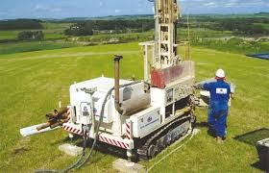
Next Steps
Technical Work
  On-site ground investigations start before Xmas
  Preferred structure type and schematics
Ongoing consultation
  Businesses, landowners and developers
Select the preferred option (SDC can
choose what it can pay for)
Consult on Preferred location and barrier appearance - Spring 2017

